Slide 1
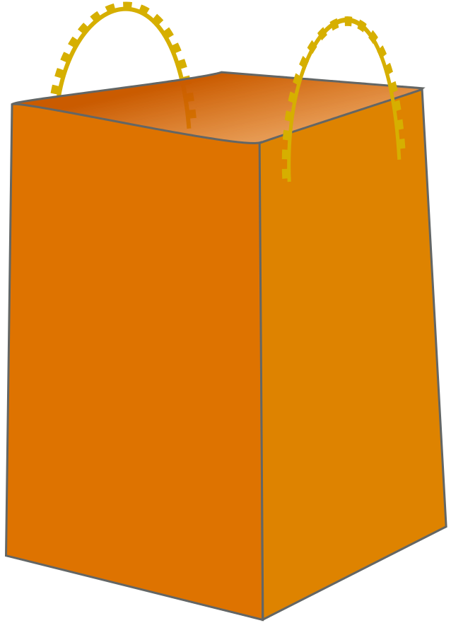
Mayank Johri
34
x

